Slide 1

Technical Comparison of CCD and CMOS Image Sensor Technologies
ITA0510 - COMPUTER VISION
Done By
Vijay A (192511030)

Slide 2


What is an Image Sensor?
An image sensor is an electronic device that converts incoming light into electrical signals, which are then processed into digital images. It acts as the "eye" of a camera by capturing light reflected from objects and transforming it into pixel data.
Image sensors are essential components in:
Smartphones
Digital cameras
CCTV surveillance
Medical imaging equipment
Industrial inspection systems
Satellites and telescopes
The two primary image sensor technologies are:
CCD (Charge Coupled Device)
CMOS (Complementary Metal Oxide Semiconductor)
Although both perform the same basic function, they differ significantly in design, performance, power consumption, manufacturing process, and application areas.

Slide 3
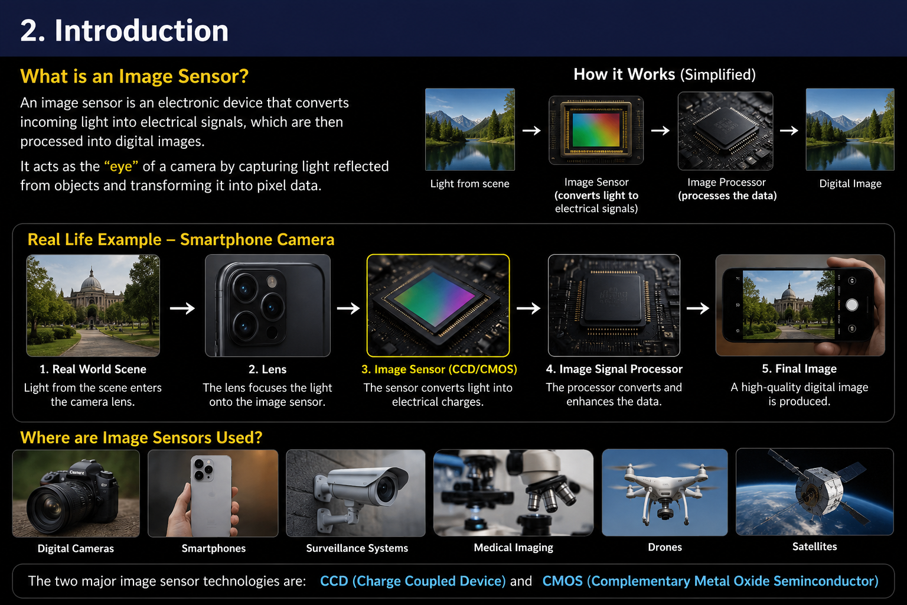
What is an Image Sensor?

Slide 4
What is CCD?
A Charge Coupled Device (CCD) is an image sensor that converts light into electrical charge. The charge from each pixel is transferred sequentially to a single output amplifier, where it is converted into a digital image.
Key Features
Single amplifier for all pixels
Sequential charge transfer
Very low electronic noise
High image quality and color accuracy
Excellent low-light sensitivity
Advantages
Superior image quality
High dynamic range
Accurate color reproduction
Limitations
High power consumption
Slower image readout
Expensive manufacturing

Slide 5
What is CMOS?
A Complementary Metal Oxide Semiconductor (CMOS) sensor converts light into electrical signals. Each pixel has its own amplifier, allowing parallel readout for faster image processing.
Key Features
Amplifier in every pixel
Parallel pixel readout
Low power consumption
Fast image capture
Easy processor integration
Advantages
High-speed performance
Low manufacturing cost
Better battery efficiency
Limitations
Higher noise in older sensors
Rolling shutter effect
Examples: Smartphones, DSLR cameras, CCTV, drones, autonomous vehicles.

Slide 6
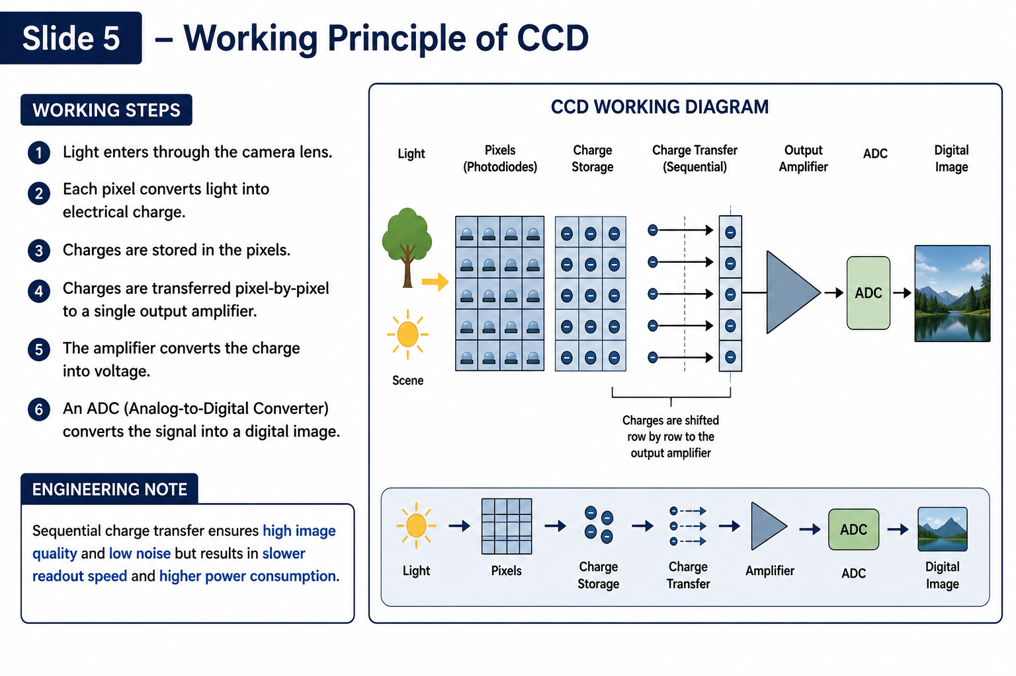
Working Principle of CCD

Slide 7
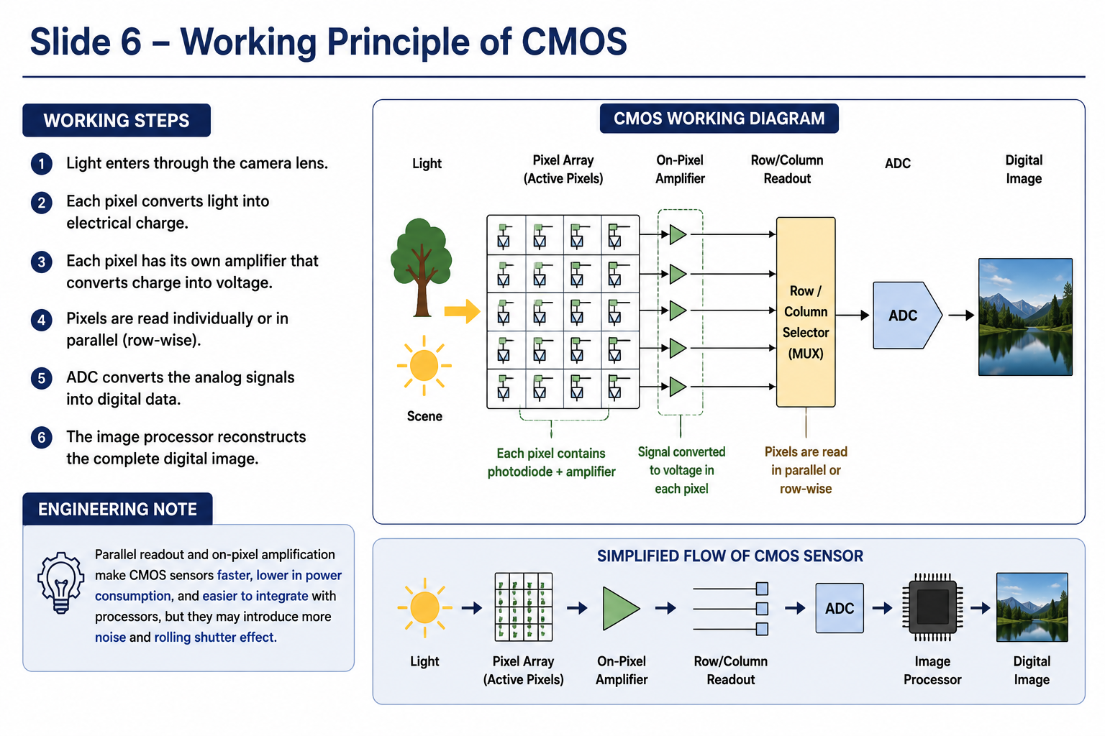
Working Principle of CMOS

Slide 8
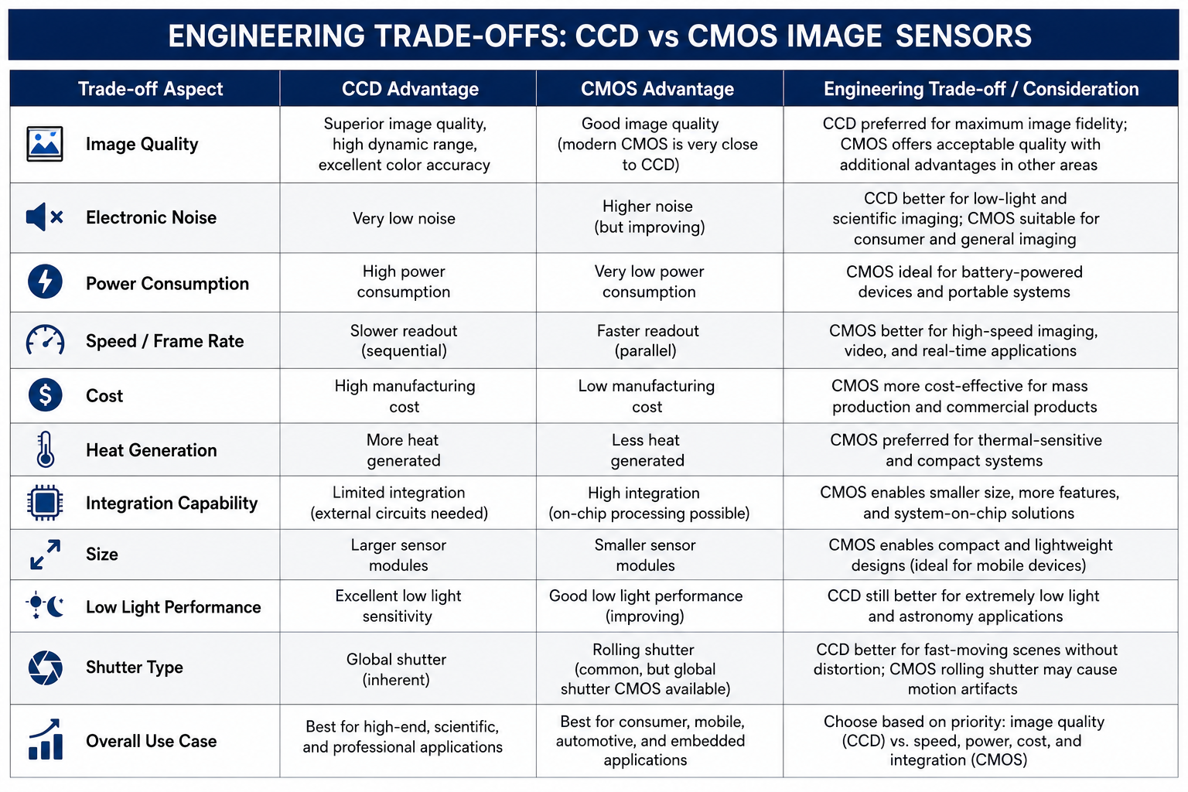
Engineering Trade-offs

Slide 9
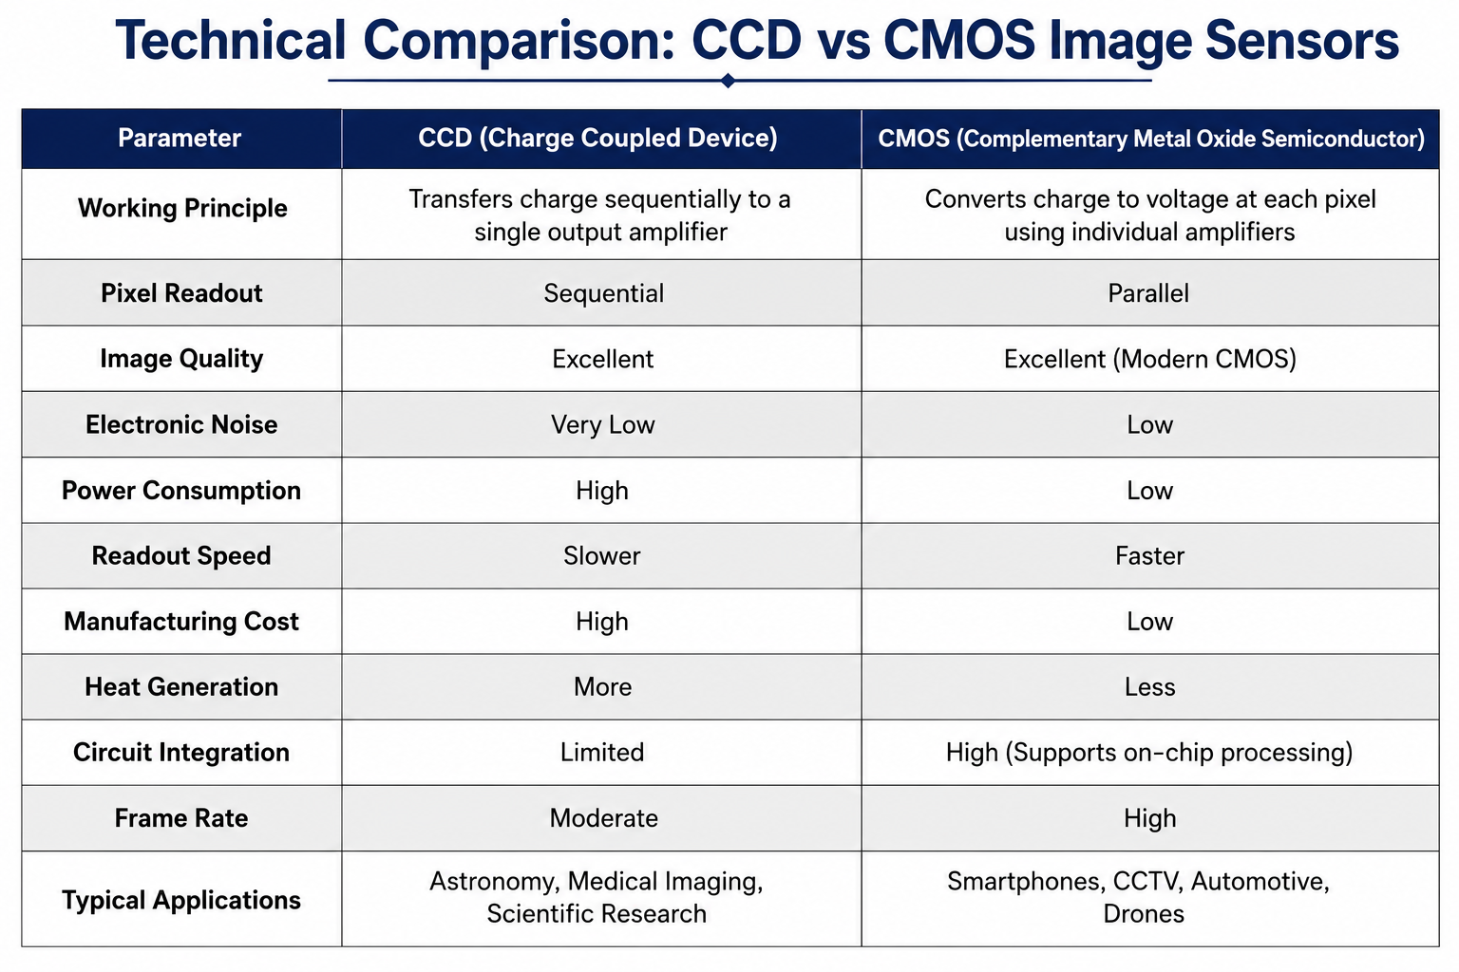
Technical Comparison

Slide 10
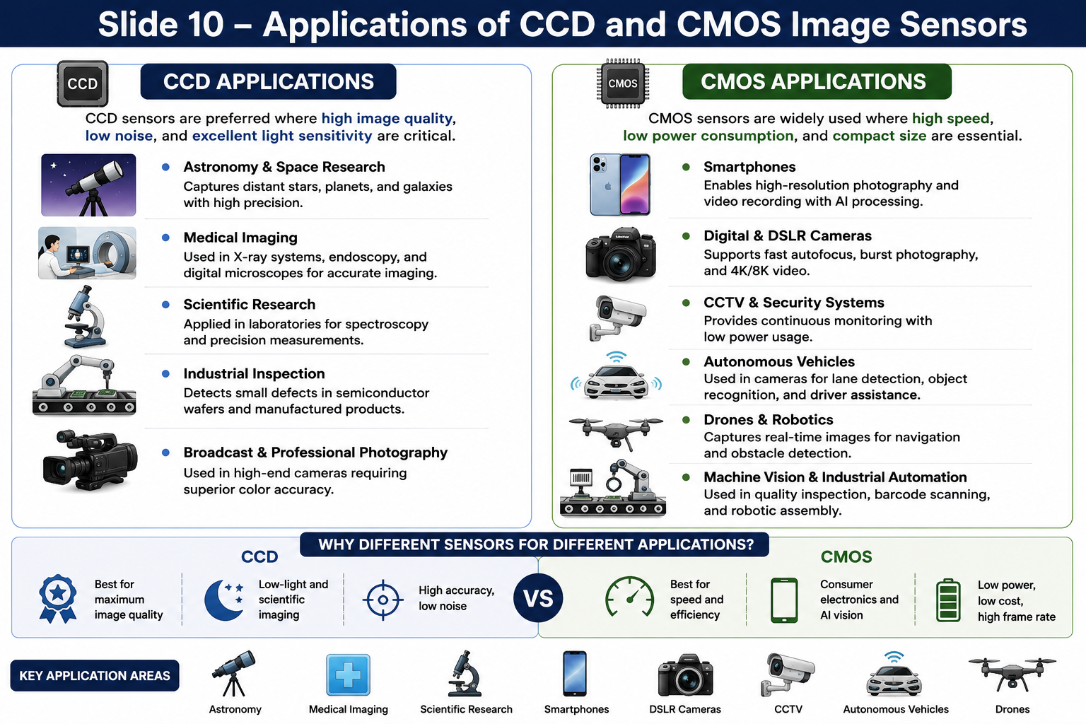
Applications

Slide 11


